Slide 1
IMAGE CLASSIFICATION TRAINING WITHOUT HACKING A DATA CENTER – A SEMI-SUPERVISED APPROACH
Sarah Gingichashvili, Rachel Shitrit, David Wajnryt
Mentor: Avram Golbert
September 25th, 2019
Hebrew University of Jerusalem

Slide 2
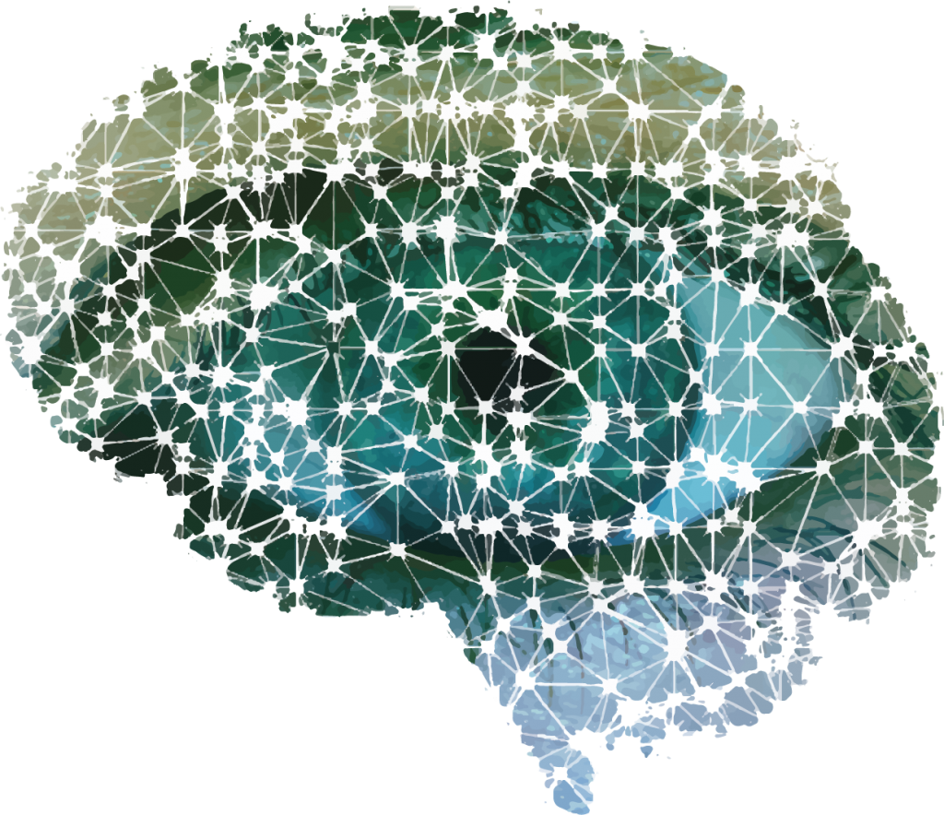
DO YOU HAVE AN ENDLESS SUPPLY OF DATA?
Over 14 million images in ImageNet
Accuracy of over 95% has been achieved in recent years
Moderately easy data collection in image processing
Very difficult in almost any other domain
Thus, one important aspect of machine learning is achieving good results with less data required

Slide 3
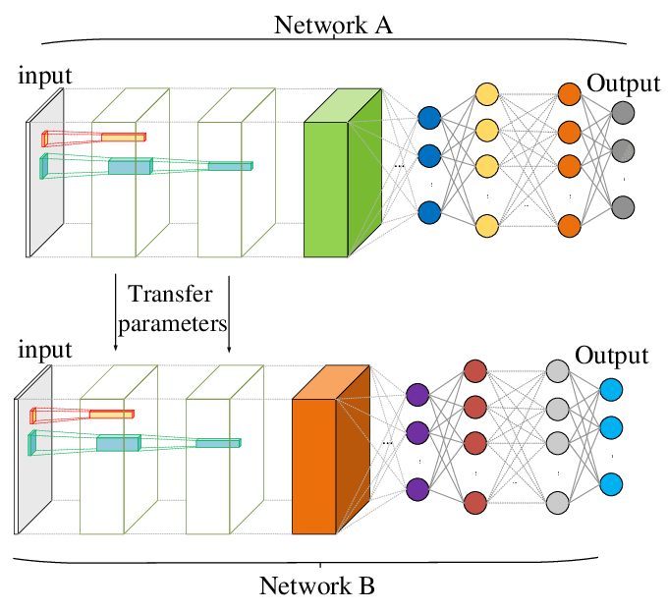
POSSIBLE SOLUTION - Transfer learning

Slide 4
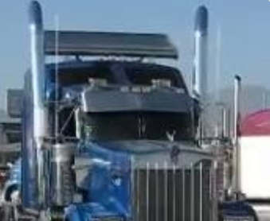
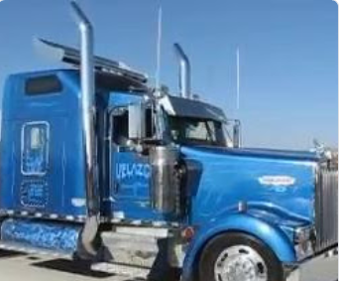
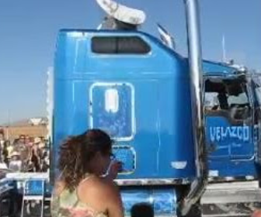
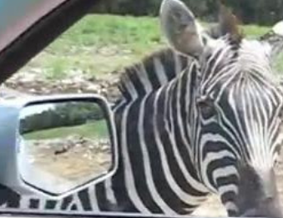
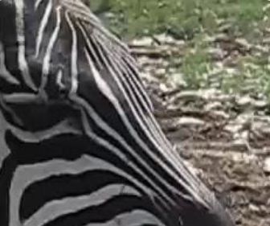
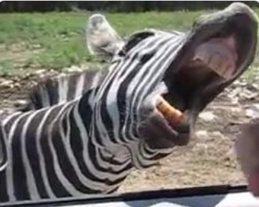
Our solution – a semi-supervised approach
It is easier to learn to recognize a particular person or object rather than the category to which it belongs
6476 object instances
...but only 23 object classes
Pretrain an instance classification network and use it in a class classification network
Object tracking algorithms allow us to get a free labeled dataset of instances from online videos

Slide 5

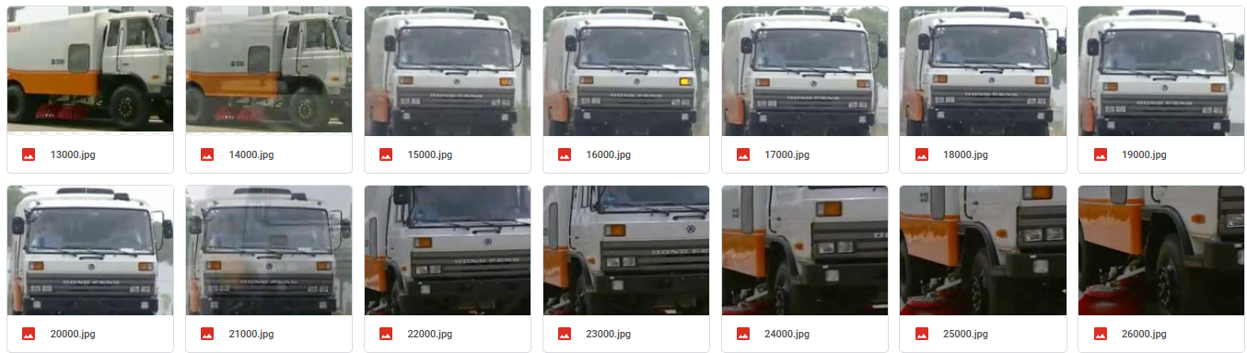




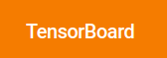
TOOLS, RESOURCES AND CHALLENGES

Slide 6
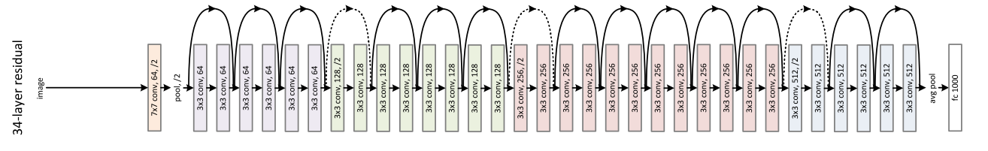
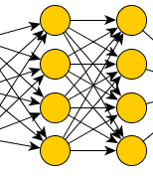

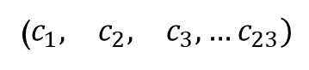
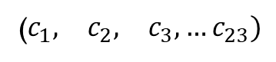
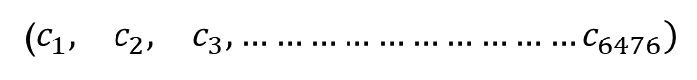
ResNet18
($\begin{matrix}c_{1}, & c_{2}, & c_{3},…c_{23})\end{matrix}$
Class classifier
23 classes
($\begin{matrix}c_{1}, & c_{2}, & c_{3},…………………………c_{6476})\end{matrix}$
Instance classifier
6345 instances
($\begin{matrix}c_{1}, & c_{2}, & c_{3},…c_{23})\end{matrix}$
23 classes
Class classifier
What’s the benefit here?

Slide 7
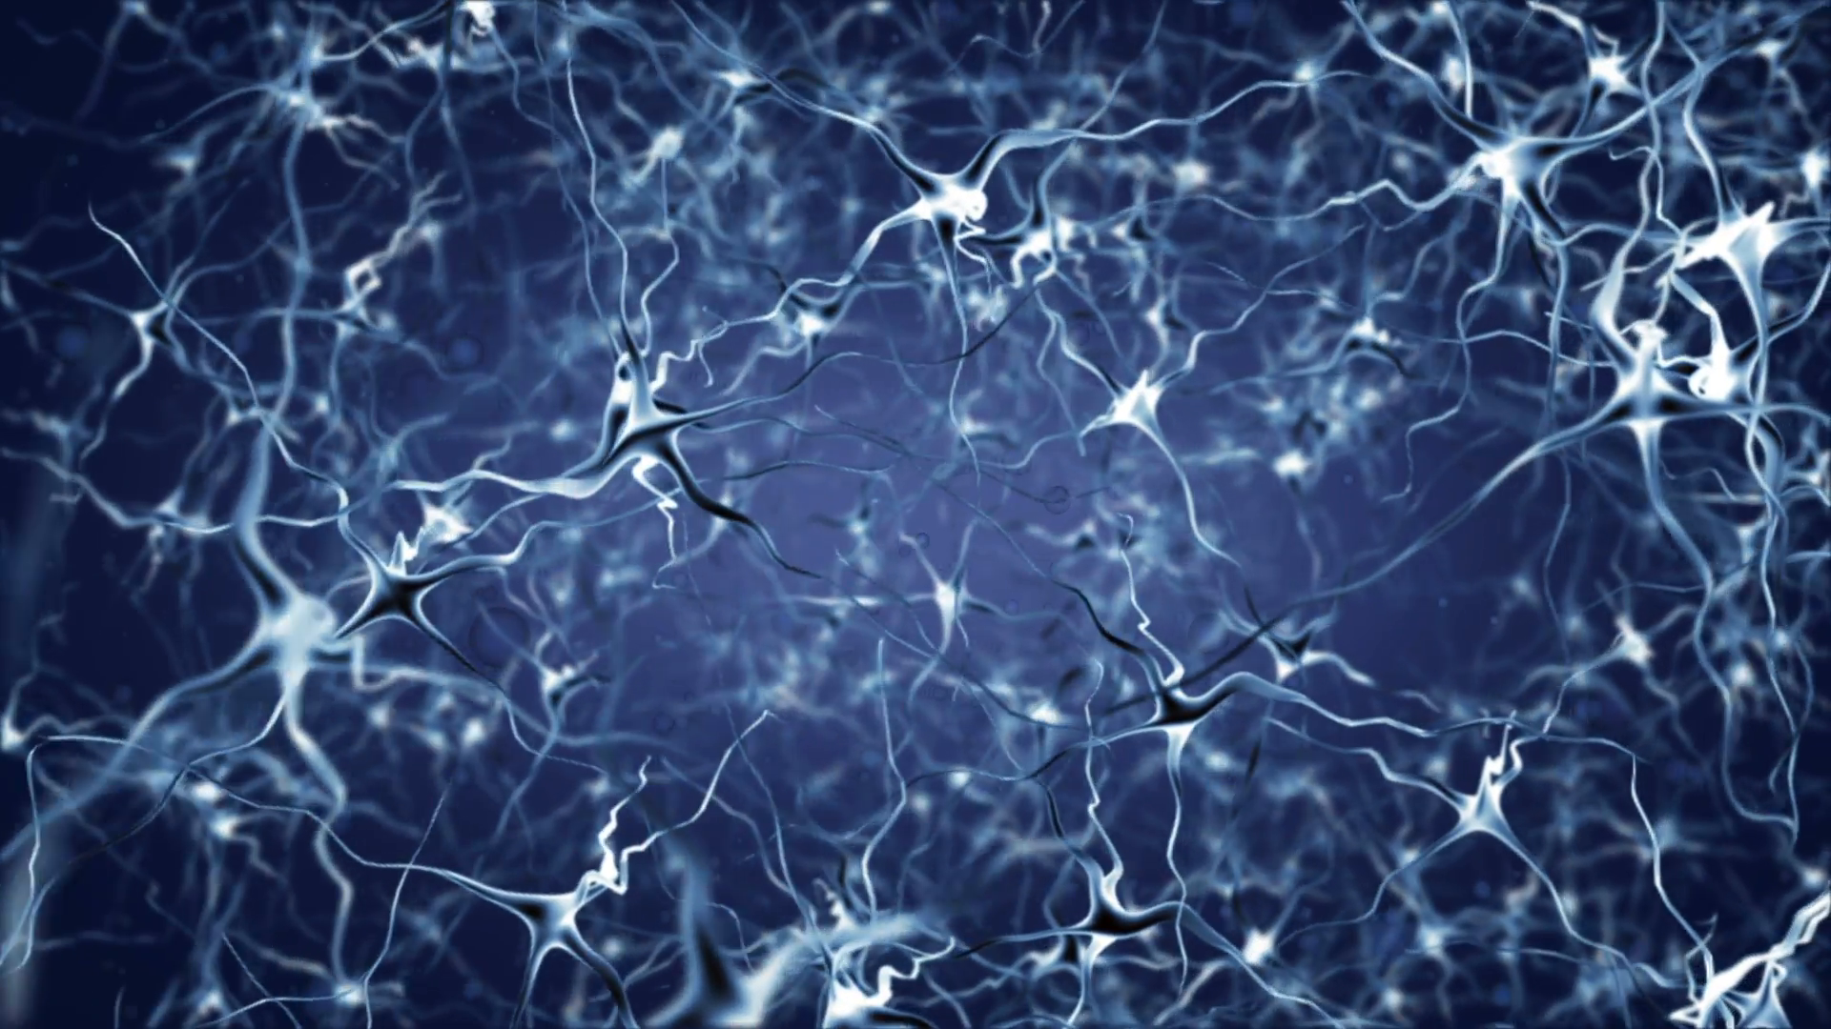
THANK YOU

